Slide 1
Search Engine Optimization

Slide 2

Discover / Crawling
Find Books
Relevance/ Indexing
Categorize Books
Think like a customer
Authority/ Ranking
Decide which books to feature
Notes:
Discovery, relevance, and authority – those are the three stages that cover how search engines work in a nutshell. And each of these three stages correlates with an action the search engine takes: crawling, indexing, and ranking.
First is the DISCOVERY stage. Search engine bots discover your web page by “crawling” it – which really just means it discovers your web page and takes note of all of the content within it. Next is the RELEVANCE stage. Once a search engine bot discovers your content, it decides how relevant it is to certain search queries by indexing it, based on signals like keywords within the content. Next is the AUTHORITY stage. This means building enough credibility through backlinks and other factors, that search engines consider your site authoritative enough to rank high in the search results. Authority directly impacts ranking strength.
I find the best way to explain how search engines rank content is using the library metaphor. After all, isn’t Google just a giant library? Let’s pretend for a moment that you work in a library. You have a ton of books in a pile in front of you, and you need to figure out where in the library these books need to be stored. This is a GREAT way to think about how Google finds, analyzes, and ranks content. Your first step is to FIND all these books. This is CRAWLING. If a book isn’t in the stack to begin with or you can’t see it, you won’t be able to put it on a shelf. That’s the discovery stage. In the sense of a website: Do you have a piece of content, and can the search engines access it? Your second step is to CATEGORIZE the books. This is INDEXING. The books in your library cover all sorts of topics: fiction, nonfiction, science, history, and technology. How do you sort them? This is where you assess the relevance of a book to a topic – by looking at the title, flipping through some pages, and seeing who the author is and whether they’re known for writing about certain topics. Search engine bots index content on a website in a similar way. They crawl the content and say, ‘What are the contents of this web page? What do they mean? Then, they bucket them into some sort of topic and start to create some semantic associations. Your third step is figuring out which books to feature. What should go on your best-sellers shelf? Which books should you make easier to find than others? This is RANKING. The way you determine which books are most easily discoverable for visitors to your library is mostly based on whether the book comes from credible sources. So, how do you determine authority? This is a subjective exercise. In the case of books, you look for credible authors like Dan Brown and H.G. Wells. Those are authoritative sources – we know that because they’re talked about a lot, referred

Slide 3
How do we determine authority?
The content is talked about a lot.
The content is referred to a lot.
The content is cited in other works
(Similar to getting backlinks)
Notes:
The key to getting your content to rank well in search is having a clear understanding of how Google finds, analyzes, and ranks your content. Getting your content to rank highly in search results depends predominantly on two things: One, improving discovery and relevance by creating lots of high-quality content on the topics you want to be known for; and two, building authority by getting lots of high-quality backlinks to your website. Discovery, relevance, and authority – those are the three stages that cover how search engines work in a nutshell. And each of these three stages correlates with an action the search engine takes: crawling, indexing, and ranking. First is the DISCOVERY stage. Search engine bots discover your web page by “crawling” it – which really just means it discovers your web page and takes note of all of the content within it. Next is the RELEVANCE stage. Once a search engine bot discovers your content, it decides how relevant it is to certain search queries by indexing it, based on signals like keywords within the content. Next is the AUTHORITY stage. This means building enough credibility through backlinks and other factors, that search engines consider your site authoritative enough to rank high in the search results. Authority directly impacts ranking strength.

Slide 4
On- Page Optimization
Off- Page Optimization
Think like a customer
Technical Optimization
Notes:
Key Areas of SEO. Tactics needed for a SEO strategy. Off page SEO acions you can take outside your website. It is like Public Relation. How can you get links from the other wesbites. Technical SEO is realted to coding of webiste. Due to pausity of time we will focus our discussion on On-page and off-page SEO

Slide 5


Anatomy of Search Result
Programs that search documents for specified keywords and return a list of the documents where the keywords were found.

Slide 6
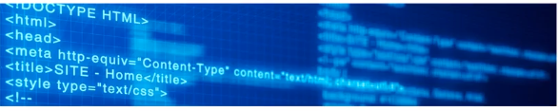
Title Tag optimization
Place keywords in the start and brand name end of the title tag
Use individual key words rather than keyword phrase
Use brand name at the end of the title tag
Title tag should be no longer than 55 – 60 characters
.

Slide 7
Meta Description optimization
Include Keywords
Include Call to action
Looks better if the end is not cut off (150-160 words are ideal)
Avoid Quotation
.

Slide 8
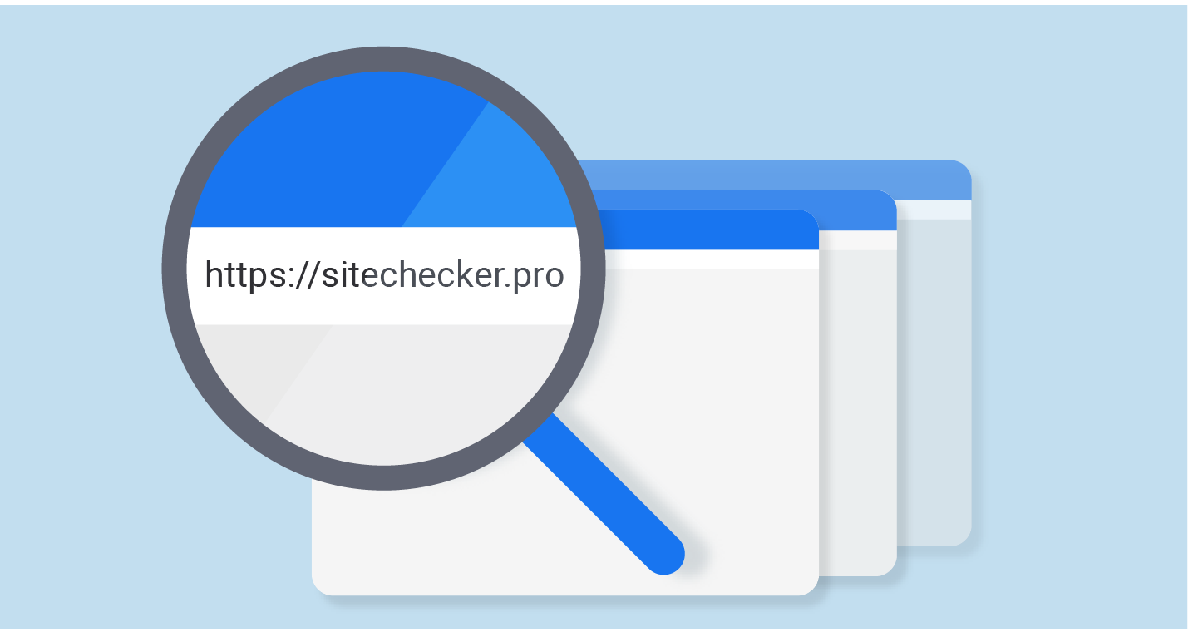
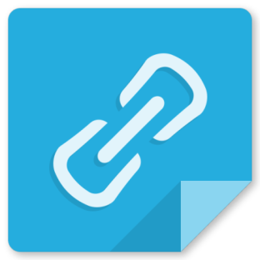
URL optimization
URL is address that loads a particular site or page
Place keyword in the beginning of the URL
Keywords are used in the sub-directories
Changing URL is a well though decision

Slide 9
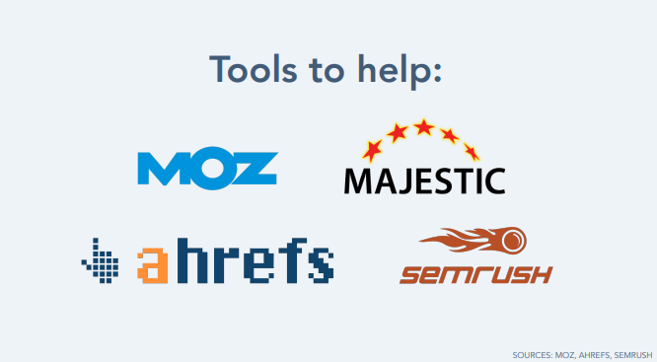
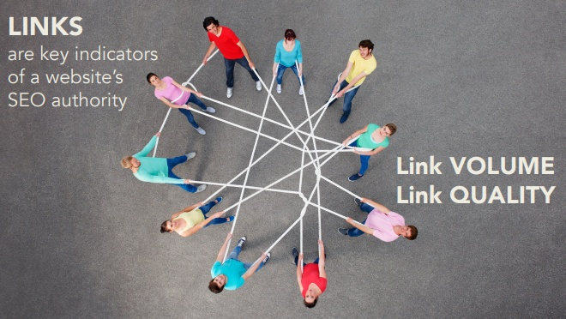

Slide 10

Google primarily measures through Backlinks!
More Backlinks
+
Higher quality Backlinks
= Higher ranking in Search

Slide 11
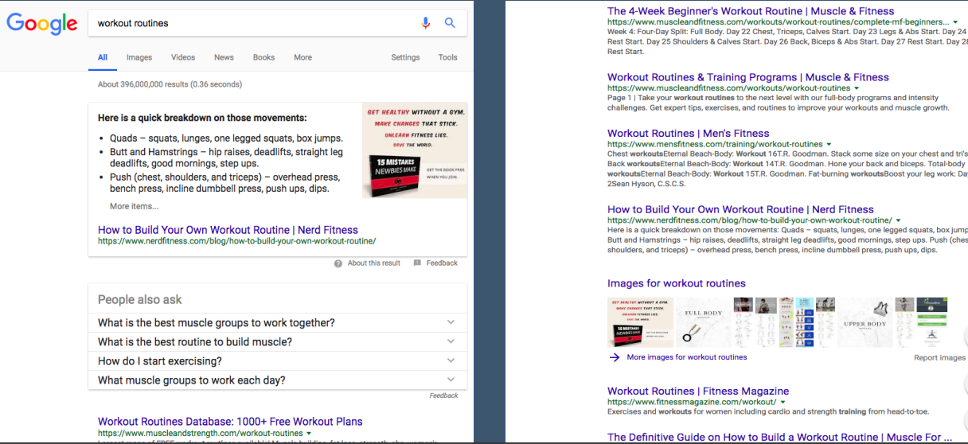
How many Backlinks should we target ??

Slide 12
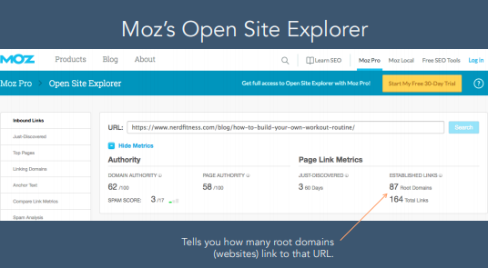
Programs that search documents for specified keywords and return a list of the documents where the keywords were found.

Slide 13
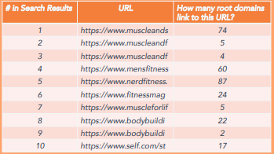
Calculate average no. of # root domains (backlinks)!
Average is 30
You will need atleast 30 backlinks from unique websites to compete with these top ten sites to increase your chances of getting listed on page 1.

Slide 14
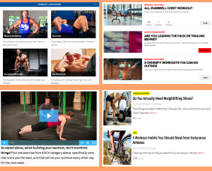
Do not try to stand out and create a piece of content that’s really different and unique, which none of these sites have.

Slide 15
3
Web Analytics

Slide 16
Programs that search documents for specified keywords and return a list of the documents where the keywords were found.
What is Web Analytics?
The measurement, collection, analysis and reporting of internet data for the purpose of understanding and optimizing we usage
Data Analytics Association

Slide 17
Programs that search documents for specified keywords and return a list of the documents where the keywords were found.
Key Terminology
Cookies
Session
Page Views
Session Duratio-n
Bounce Rate
Goals

Slide 18
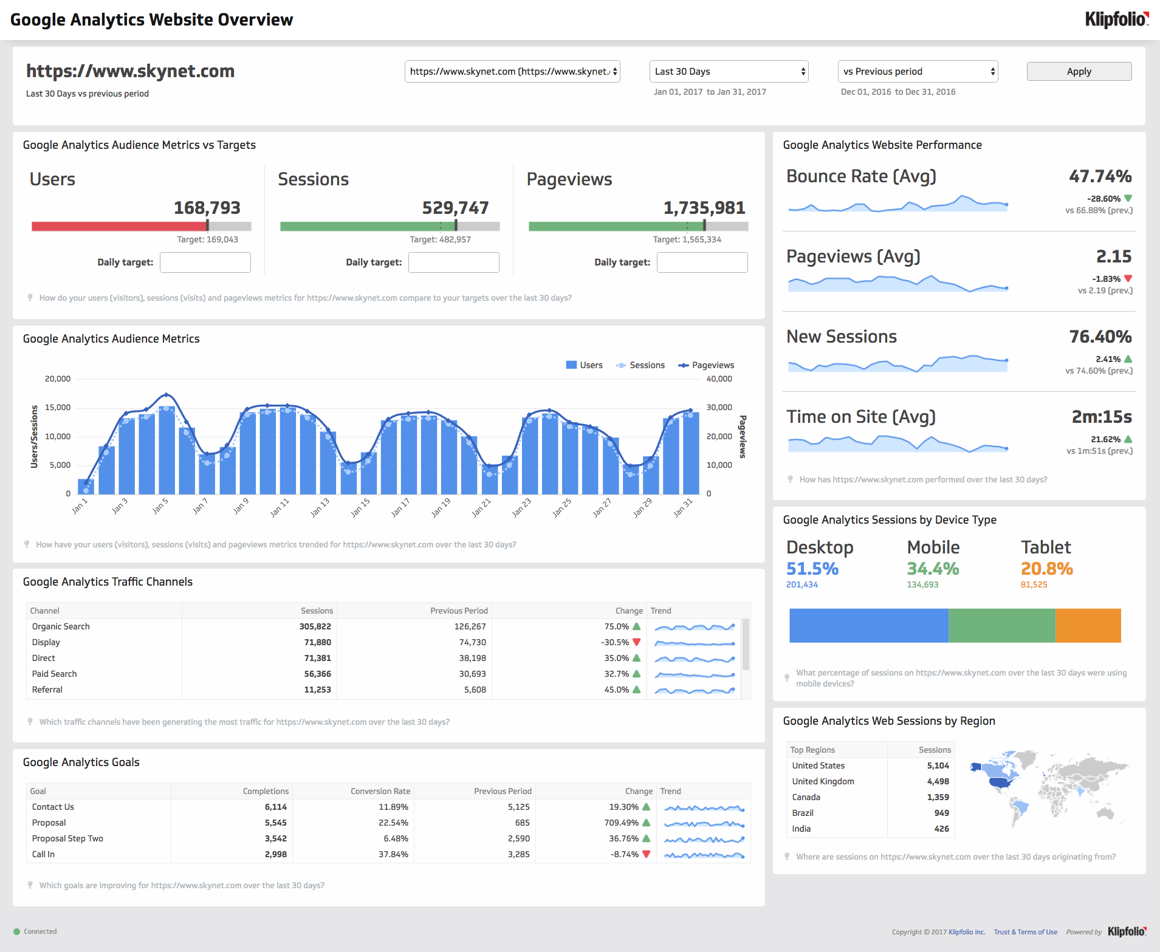
What are my visitors doing?
Are they getting it done?
Think like a customer
How can I get more of these visitors?

Slide 19
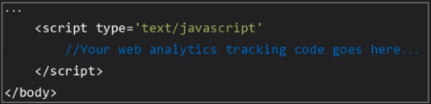
Programs that search documents for specified keywords and return a list of the documents where the keywords were found.
Tag each Page
Add Javascript code snippet into the HTML code of each page

Slide 20
Programs that search documents for specified keywords and return a list of the documents where the keywords were found.
Set Goals
What do you want users to do in your website?
Identify the navigation path
Arrive at the site
Select the service
Proceed to payme-nt
Reciept

Slide 21
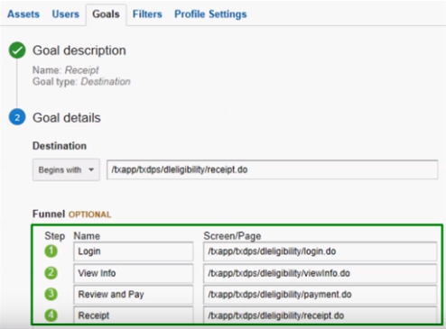
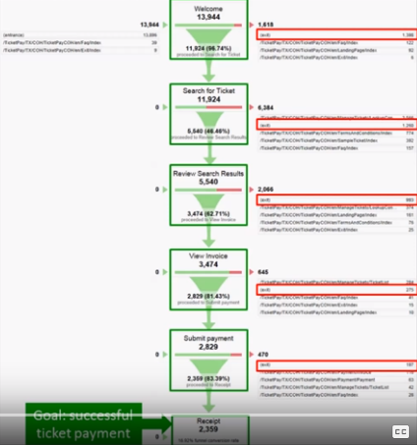

Slide 22
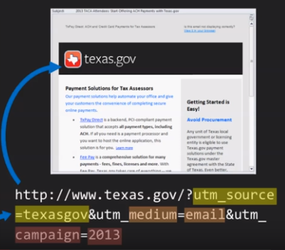
Tag your campaigns/contents/ blogs/tabs to measure their effectiveness

Slide 23
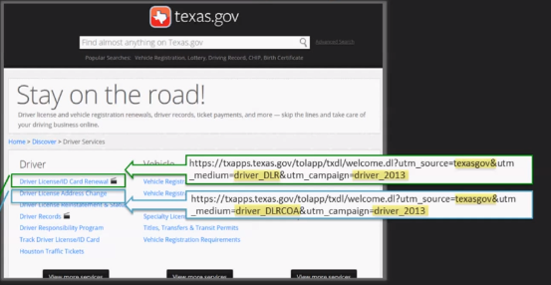
Tag the tabs/links/
URL on the website
Campaign Report
Source/ Medium | Visits | Goal Conversion rate
Deriver License renewal | 30,243 | 60.83%
Change of Address | 1,952 | 23%

Slide 24
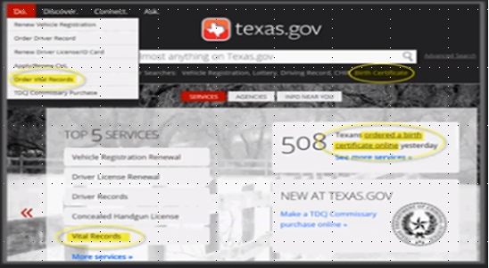
Deciding if we need a separate “Tab” for an item in our drop down menu
Campaign Report
Source/ Medium | Visits
Deriver License renewal | 30,243
Change of Address | 1,952
Vital Records | 60,898

Slide 25

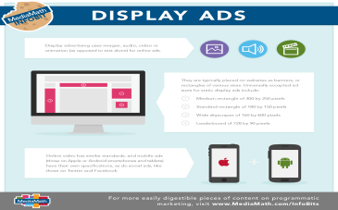
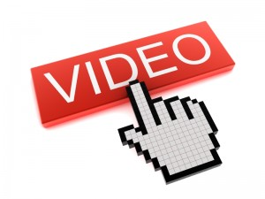

Key Search Metrics
Click Through rates (CTR)
Transaction conversion rates (TCR)
Probability of booking (CTR X TCR)
Cost per acquisition (CPA)

Slide 26
Optimize Campaign Strategy
Excel Sheet

Slide 27


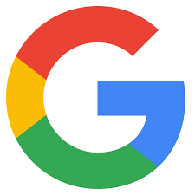
Analytics: Driving customer value
SUCCESS DEFINED
Marketing analytics is significantly more efficient
Create a compelling user experience
Develops a robust ecosystem
Data analytics is a vehicle for value creation
Next Product
Next Movie
Next Search option
27

Slide 28
https://jet522.wixsite.com/coffeeclothing
“
The purpose of the business is to create and keep customers.
- Theodore Levitt

